Slide 1

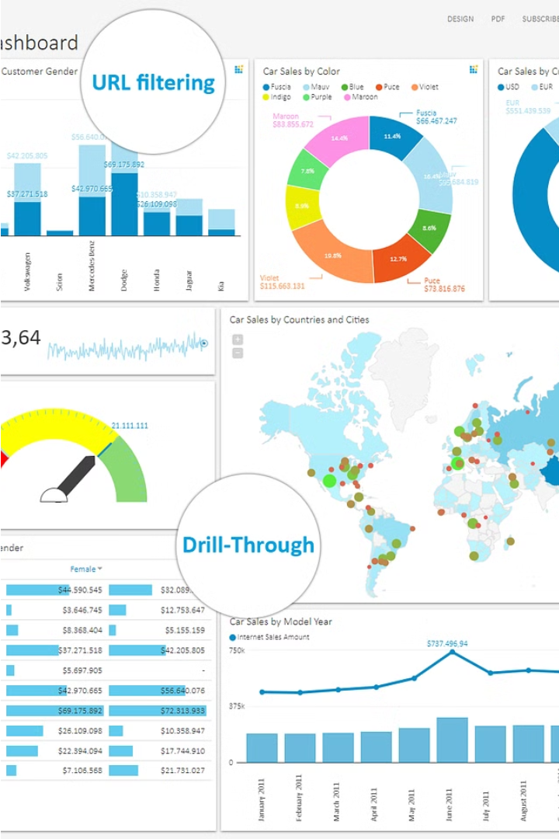

Introduction to the End-to-End Data Analytics Project with ETL Process For
Retail Order Dataset
Welcome to our comprehensive data analytics project focusing on a retail orders dataset from Kaggle. In this presentation, we'll take you through the entire journey - from data extraction and transformation using Python and SQL, to in-depth data analysis and insights.
by Saurabh Shah

Slide 2
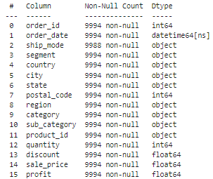
Overview of the Retail Orders Dataset from Kaggle
The Retail Orders dataset from Kaggle is a comprehensive dataset containing information about online orders placed by customers of a major retail company. The dataset includes details such as order date, ship date, ship mode, customer name, segment, country, city, state, postal code, region, product ID, category, sub-category, product name, sales, quantity, and discount.
This dataset provides a wealth of data that can be leveraged to uncover valuable insights about customer behavior, sales trends, and supply chain performance for the retail business.

Slide 3



ETL Process using Python
Extract the Data
To extract data from Kaggle using the Kaggle API in Python, use the kaggle library to download datasets and competition files, making it ready for further processing.
Transform Data
Examine the column names, data types, transform data using the pandas library in Python, Rename the column name, add some calculated column.
Load the Data
load data to SQL Server using Python's SQLAlchemy library and the to_sql() function.

Slide 4
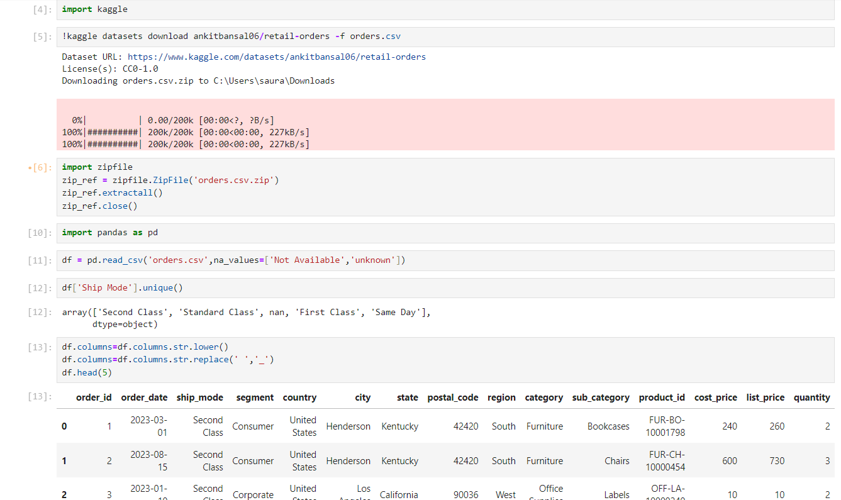
ETL Process using Python(1)

Slide 5
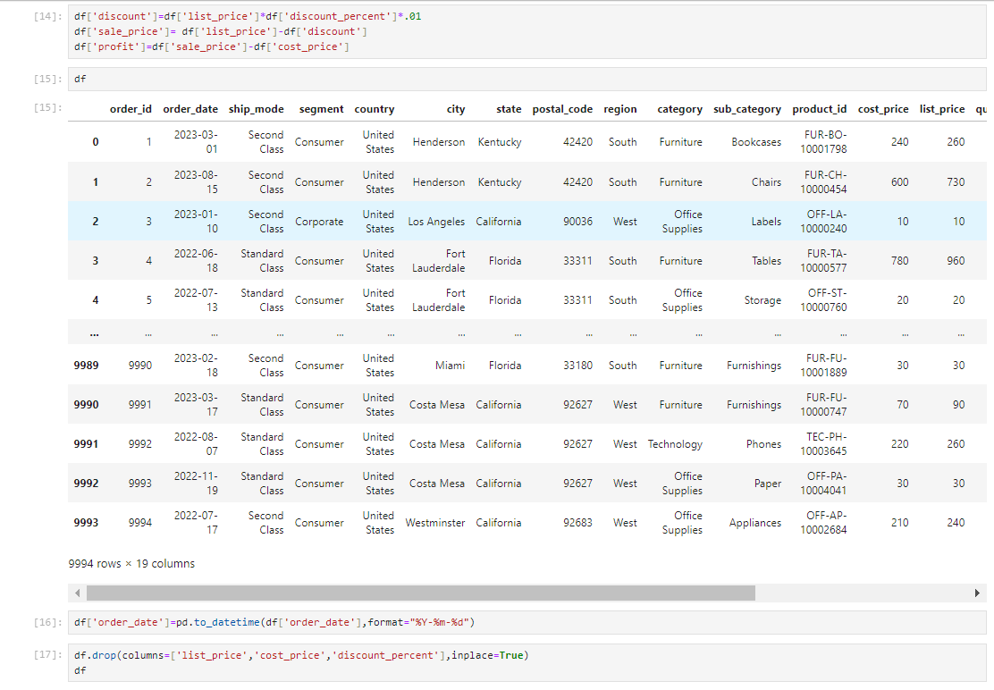
ETL Process using Python(2)

Slide 6
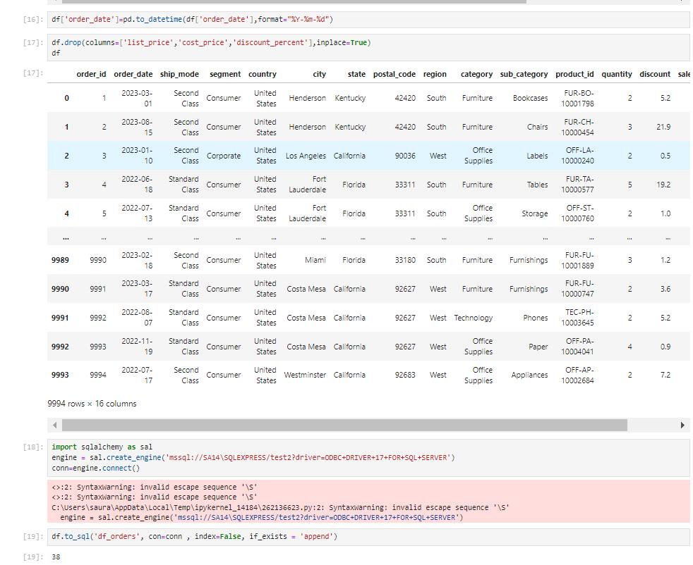
ETL Process using Python(3)

Slide 7
SQL QUERIES

Slide 8
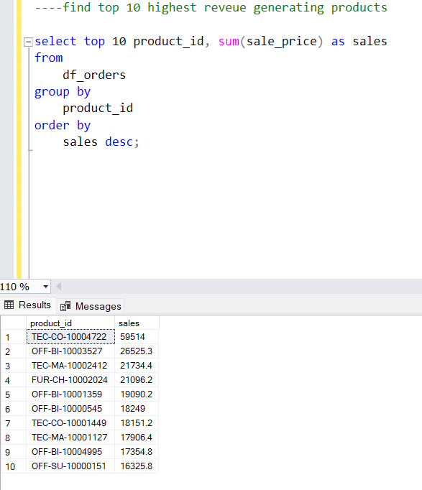
Find top 10 highest revenue generating products.

Slide 9
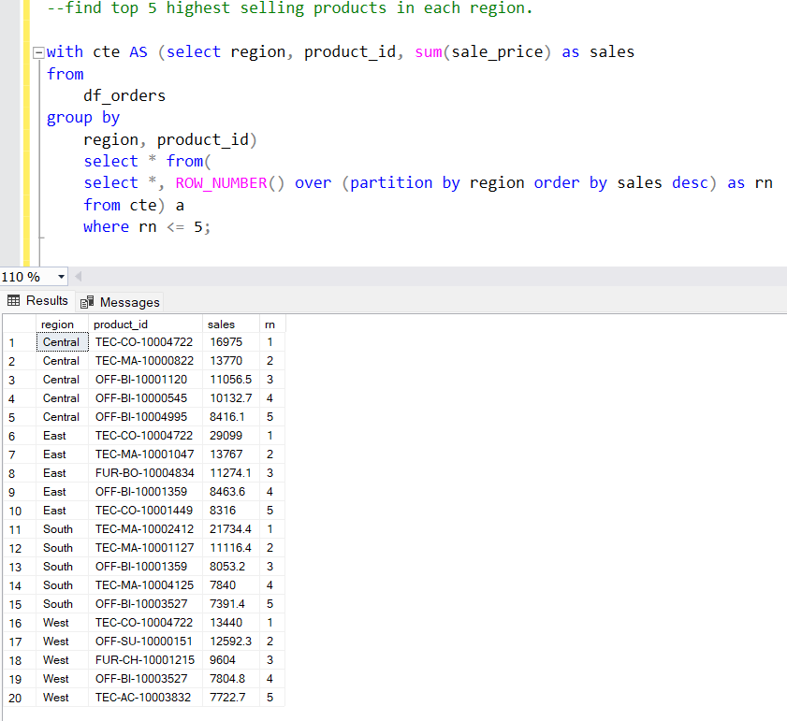
Find top 5 highest selling products in each region.

Slide 10
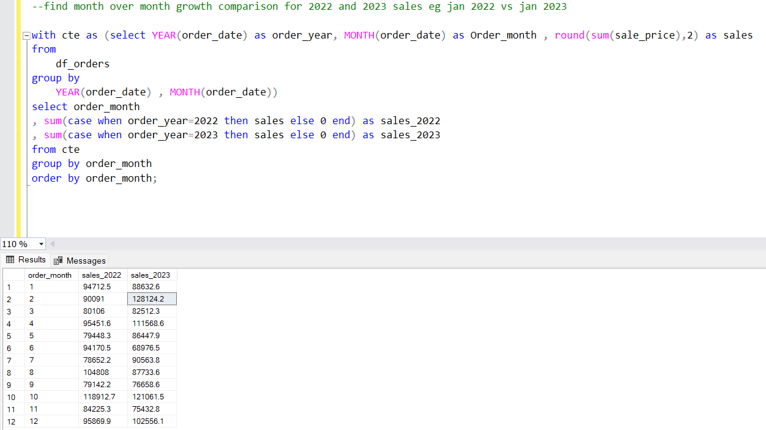
Find month over month growth comparison for 2022 and 2023 sales eg jan 2022 vs jan 2023.

Slide 11
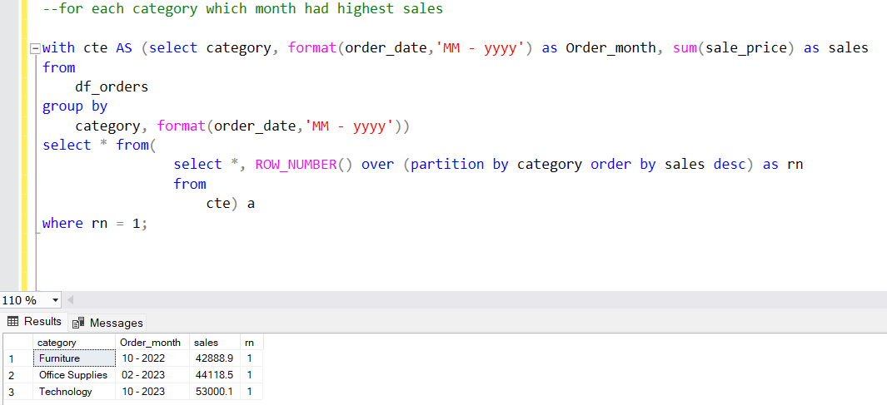
For each category which month had highest sales.

Slide 12
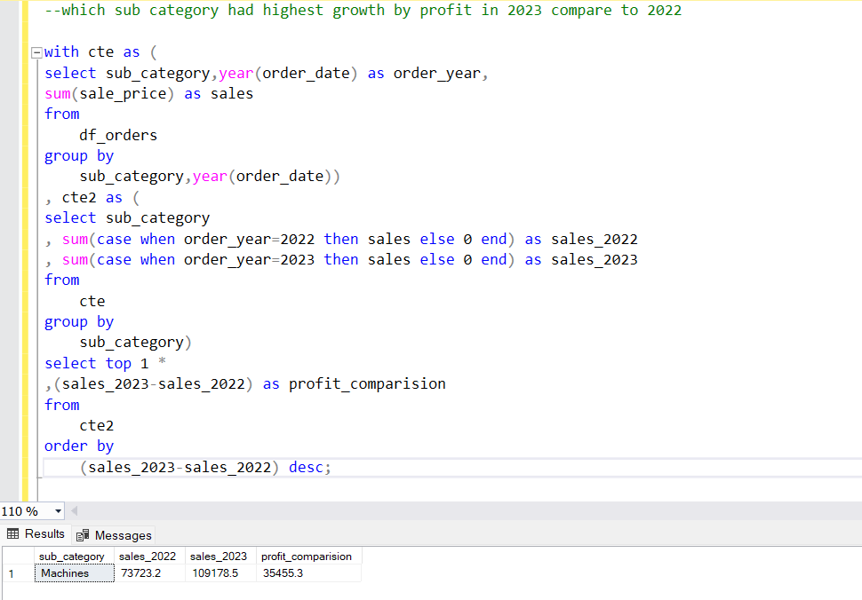
Which sub category had highest growth by profit in 2023 compare to 2022.

Slide 13
Recommendations and Actionable Insights
Optimize Inventory Management
Enhance Customer Engagement
Analyze historical sales data to identify best-selling products and optimize inventory levels accordingly. This can help reduce stockouts and overstocking.
Utilize customer purchase patterns to personalize product recommendations and offers. This can improve customer satisfaction and encourage repeat business.
Streamline Logistics
Leverage Data-Driven Decisions
Identify bottlenecks in the supply chain and implement process improvements to enhance delivery times and reduce shipping costs.
Continually analyze sales data, customer feedback, and market trends to make informed, data-driven decisions that drive business growth.

Slide 14

Conclusion and Next Steps
In this end-to-end data analytics project, we've demonstrated a comprehensive workflow for extracting, transforming, and analyzing retail order data. By leveraging the power of Python and SQL, we've uncovered valuable insights that can drive strategic decision-making.

Slide 15
THANK
YOU

